Slide 1
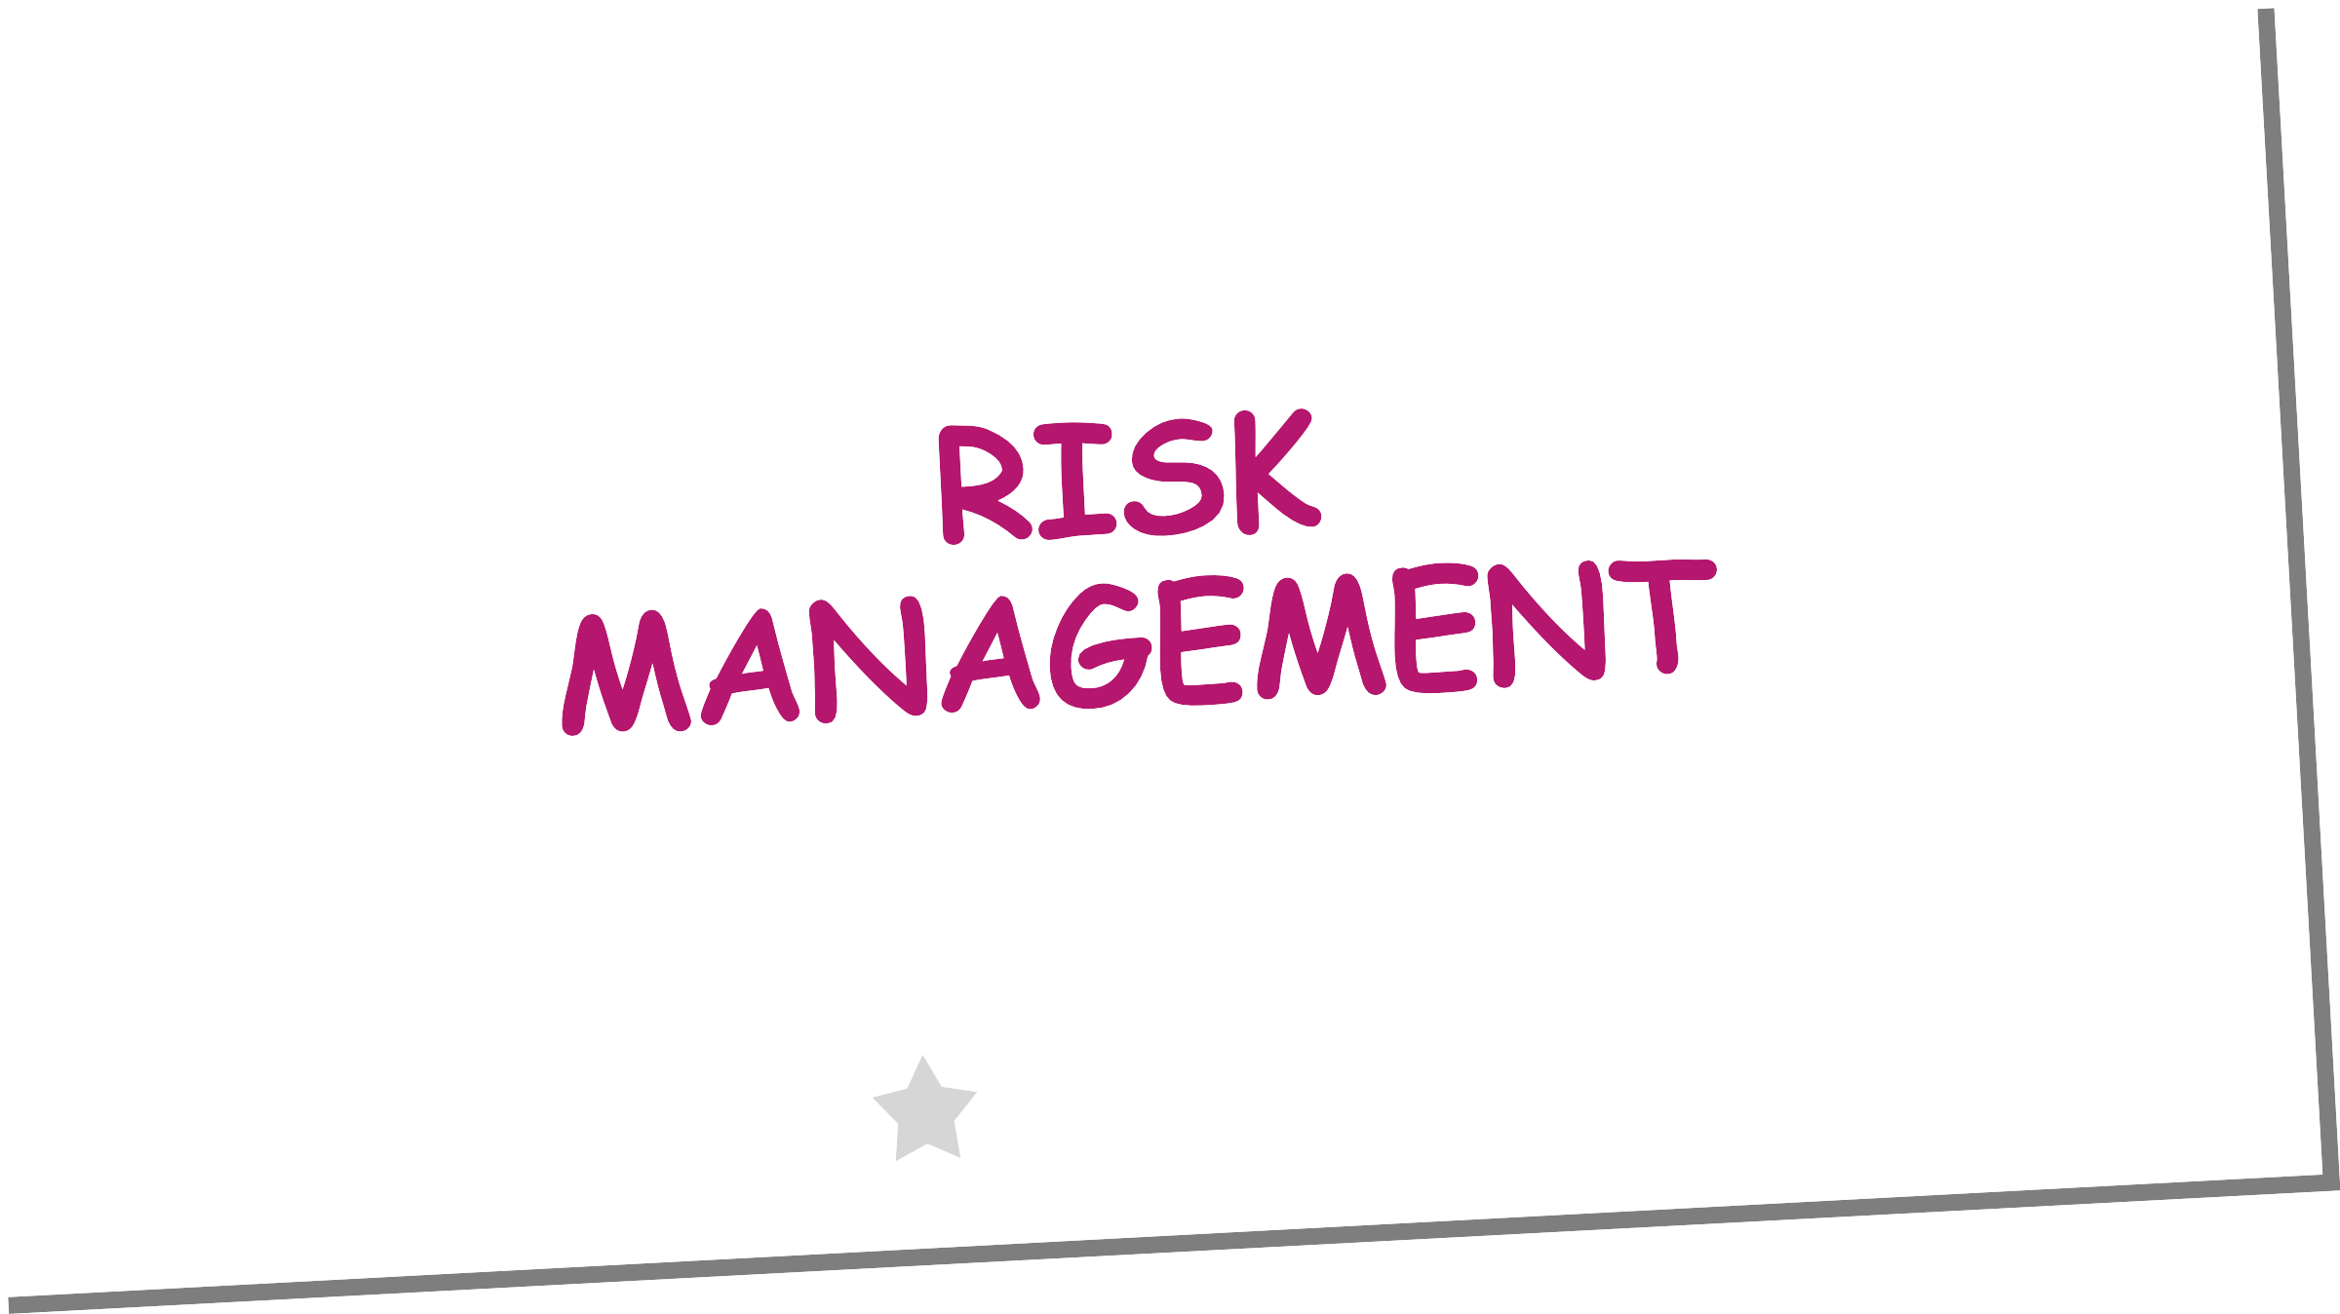

Slide 2
Risk vs Problem
RISK IS AN UNCERTAINTY (FEAR OF UNKNOWN).
PROBLEM IS SOME EVENT WHICH HAS ALREADY OCCURRED BUT RISK IS SOMETHING THAT IS UNPREDICTABLE.
pSG cOLLEGE OF tEchnOLOGy

Slide 3
Risk Categorization
KNOWN RISKS
THOSE RISKS THAT CAN BE UNCOVERED AFTER CAREFUL EVALUATION OF THE PROJECT PLAN, THE BUSINESS AND TECHNICAL ENVIRONMENT IN WHICH THE PROJECT IS BEING DEVELOPED, AND OTHER RELIABLE INFORMATION SOURCES (E.G., UNREALISTIC DELIVERY DATE)
PREDICTABLE RISKS
THOSE RISKS THAT ARE EXTRAPOLATED FROM PAST PROJECT EXPERIENCE (E.G., PAST TURNOVER)
UNPREDICTABLE RISKS
THOSE RISKS THAT CAN AND DO OCCUR, BUT ARE EXTREMELY DIFFICULT TO IDENTIFY IN ADVANCE.
pSG cOLLEGE OF tEchnOLOGy

Slide 4
Reactive vs. Proactive Risk Strategies
REACTIVE RISK STRATEGIES
THE MAJORITY OF SOFTWARE TEAMS AND MANAGERS RELY ON THIS APPROACH
NOTHING IS DONE ABOUT RISKS UNTIL SOMETHING GOES WRONG
THE TEAM THEN FLIES INTO ACTION IN AN ATTEMPT TO CORRECT THE PROBLEM RAPIDLY(FIREFIGHTING)
CRISIS MANAGEMENT IS THE CHOICE OF MANAGEMENT TECHNIQUES
pSG cOLLEGE OF tEchnOLOGy

Slide 5
Reactive vs. Proactive Risk Strategies
PROACTIVE RISK STRATEGIES
STEPS FOR RISK MANAGEMENT ARE FOLLOWED
PRIMARY OBJECTIVE IS TO AVOID RISK AND TO HAVE A CONTINGENCY PLANING PLACE TO HANDLE UNAVOIDABLE RISKS IN A CONTROLLED AND EFFECTIVE MANNER
pSG cOLLEGE OF tEchnOLOGy

Slide 6




GUESS THE CATEGORY OF RISK (REACTIVE OR PROACTIVE)

Slide 7
Risk Exposure
RISK EXPOSURE IS A QUANTIFIED LOSS POTENTIAL OF BUSINESS
THE OVERALL RISK EXPOSURE FORMULA IS RE=PXC
P = THE PROBABILITY OF OCCURRENCE FOR A RISK
C = THE COST TO THE PROJECT SHOULD THE RISK ACTUALLY OCCUR
RE=σ^{𝒏}
𝐏 𝐱 𝐂
𝒊=𝟏
pSG cOLLEGE OF tEchnOLOGy

Slide 8
Risk Exposure
EXAMPLE
P=80% PROBABILITY THAT 18 OF 60 SOFTWARE COMPONENTS WILL HAVE TO BE DEVELOPED
C=TOTAL COST OF DEVELOPING 18 COMPONENTS IS $25,000
RE=0.80 X$25,000 =$20,000
pSG cOLLEGE OF tEchnOLOGy

Slide 9
RISK ASSESSMENT MATRIX
SEVERITY:
THE IMPACT OF A RISK AND THE NEGATIVE CONSEQUENCES THAT WOULD RESULT.
LIKELIHOOD:
THE PROBABILITY OF THE RISK OCCURRING.
pSG cOLLEGE OF tEchnOLOGy

Slide 10
Severity
INSIGNIFICANT:
RISKS THAT BRING NO REAL NEGATIVE CONSEQUENCES, OR POSE NO SIGNIFICANT THREAT TO THE ORGANIZATION OR PROJECT.
MINOR:
RISKS THAT HAVE A SMALL POTENTIAL FOR NEGATIVE CONSEQUENCES, BUT WILL NOT SIGNIFICANTLY IMPACT OVERALL SUCCESS.
MODERATE:
RISKS THAT COULD POTENTIALLY BRING NEGATIVE CONSEQUENCES, POSING A MODERATE THREAT TO THE PROJECT OR ORGANIZATION.
CRITICAL:
RISKS WITH SUBSTANTIAL NEGATIVE CONSEQUENCES THAT WILL SERIOUSLY IMPACT THE SUCCESS OF THE ORGANIZATION OR PROJECT.
CATASTROPHIC:
RISKS WITH EXTREME NEGATIVE CONSEQUENCES THAT COULD CAUSE THE ENTIRE PROJECT TO FAIL OR SEVERELY IMPACT DAILY OPERATIONS OF THE ORGANIZATION. THESE ARE THE HIGHEST- PRIORITY RISKS TO ADDRESS.
pSG cOLLEGE OF tEchnOLOGy

Slide 11
Likelihood
UNLIKELY:
EXTREMELY RARE RISKS, WITH ALMOST NO PROBABILITY OF OCCURRING.
SELDOM:
RISKS THAT ARE RELATIVELY UNCOMMON, BUT HAVE A SMALL CHANCE OF MANIFESTING.
OCCASIONAL:
RISKS THAT ARE MORE TYPICAL, WITH ABOUT A 50/50 CHANCE OF TAKING PLACE.
LIKELY:
RISKS THAT ARE HIGHLY LIKELY TO OCCUR.
DEFINITE:
RISKS THAT ARE ALMOST CERTAIN TO MANIFEST. ADDRESS THESE RISKS FIRST.
pSG cOLLEGE OF tEchnOLOGy

Slide 12
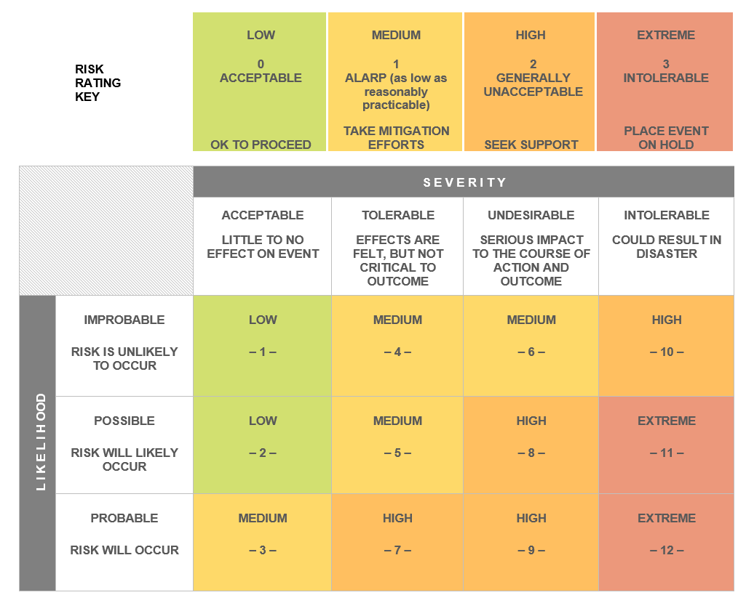
RISK ASSESSMENT MATRIX

Slide 13
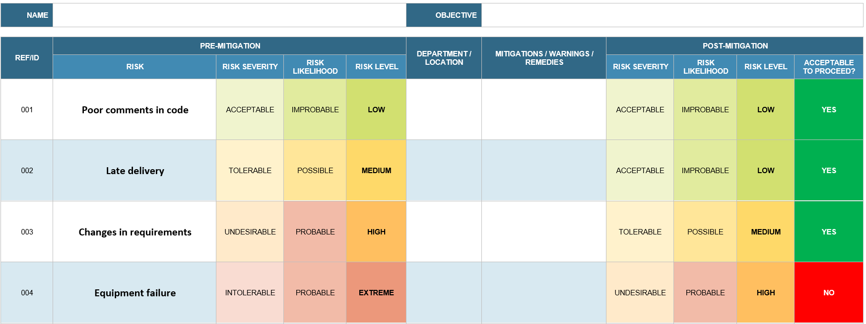
RISK MANAGEMENT MATRIX
pSG cOLLEGE OF tEchnOLOGy

Slide 14
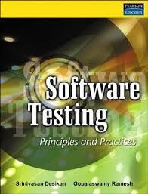



REFERENCES
pSG cOLLEGE OF tEchnOLOGy

